Slide 1



CS Bridge, Lecture 2 Karel Control Flow

Slide 2

Lecture Plan
Review
while loops and conditions
Fencepost problem

Slide 3
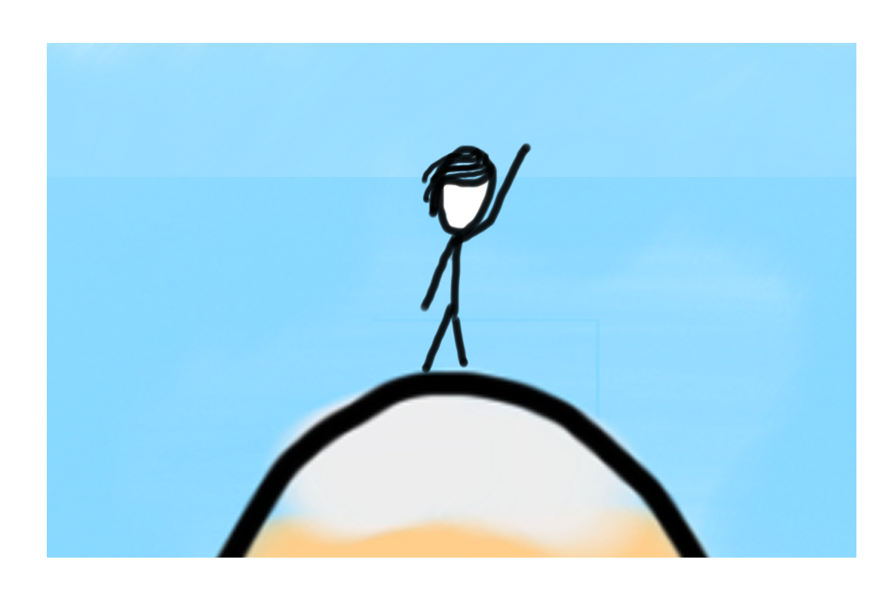

Learning Goals
Code using conditions
Trace programs that use loops and conditions

Slide 4
Lecture Plan
Review
while loops and conditions
Fencepost problem

Slide 5
A quick question!
What did you manage to get done yesterday?
(A) I wrote some Karel code!
(B) I got to meet my section!
(C) I got to finish a whole Karel problem!
(D) All of the above!!!
Notes:
Karel – from Karel Chopek, who invented the word “robot”
Old Mac with leg out its back

Slide 6
Meet Karel the Robot!
Notes:
Karel – from Karel Chopek, who invented the word “robot”
Old Mac with leg out its back

Slide 7

Karel's World
3
.
.
.
.
.
2
.
.
.
.
.
1
.
.
.
.
.
1
2
3
4
5

Slide 8
Karel Knows 4 Commands
move()
turn_left()
put_beeper()
pick_beeper()
Notes:
Don’t be deceived! Build complex things from simple commands

Slide 9
Anatomy Of A Program

Slide 10
from karel.stanfordkarel import *
"""
File: collect_newspaper_karel.py
------------------------------
Karel picks beeper in front of its house.
"""
def main():
move_to_newspaper()
# pick up newspaper
pick_beeper()
def move_to_newspaper():
"""
Karel moves from the house to the location of the newspaper.
"""
move()
move()
turn_right()
move()
turn_left()
move()
def turn_right():
"""
Karel turns right
"""
for i in range(3):
turn_left()
# There is no need to edit code beyond this point
if __name__ == "__main__":
run_karel_program()

Slide 11
from karel.stanfordkarel import *
"""
File: collect_newspaper_karel.py
------------------------------
Karel picks beeper in front of its house.
"""
def main():
move_to_newspaper()
# pick up newspaper
pick_beeper()
def move_to_newspaper():
"""
Karel moves from the house to the location of the newspaper.
"""
move()
move()
turn_right()
move()
turn_left()
move()
def turn_right():
"""
Karel turns right
"""
for i in range(3):
turn_left()
# There is no need to edit code beyond this point
if __name__ == "__main__":
run_karel_program()
The entire program is written in a .py file

Slide 12
from karel.stanfordkarel import *
"""
File: collect_newspaper_karel.py
------------------------------
Karel picks beeper in front of its house.
"""
def main():
move_to_newspaper()
# pick up newspaper
pick_beeper()
def move_to_newspaper():
"""
Karel moves from the house to the location of the newspaper.
"""
move()
move()
turn_right()
move()
turn_left()
move()
def turn_right():
"""
Karel turns right
"""
for i in range(3):
turn_left()
# There is no need to edit code beyond this point
if __name__ == "__main__":
run_karel_program()
The main function is where the program starts executing

Slide 13
from karel.stanfordkarel import *
"""
File: collect_newspaper_karel.py
------------------------------
Karel picks beeper in front of its house.
"""
def main():
move_to_newspaper()
# pick up newspaper
pick_beeper()
def move_to_newspaper():
"""
Karel moves from the house to the location of the newspaper.
"""
move()
move()
turn_right()
move()
turn_left()
move()
def turn_right():
"""
Karel turns right
"""
for i in range(3):
turn_left()
# There is no need to edit code beyond this point
if __name__ == "__main__":
run_karel_program()
We can define our own functions to teach Karel new commands

Slide 14
from karel.stanfordkarel import *
"""
File: collect_newspaper_karel.py
------------------------------
Karel picks beeper in front of its house.
"""
def main():
move_to_newspaper()
# pick up newspaper
pick_beeper()
def move_to_newspaper():
"""
Karel moves from the house to the location of the newspaper.
"""
move()
move()
turn_right()
move()
turn_left()
move()
def turn_right():
"""
Karel turns right
"""
for i in range(3):
turn_left()
# There is no need to edit code beyond this point
if __name__ == "__main__":
run_karel_program()
Multi-line comment
Single-line comment
Comments to explain our code

Slide 15
Indentation
Karel is very picky about indentation.
Everything at the same level of indentation is one block of code
def main():
move()
for i in range(4):
move()
put_beeper()
move()

Slide 16
Indentation
Karel is very picky about indentation.
Everything at the same level of indentation is one block of code
def main():
move()
for i in range(4):
move()
put_beeper()
move()

Slide 17
Indentation
Karel is very picky about indentation.
Everything at the same level of indentation is one block of code
def main():
move()
for i in range(4):
move()
put_beeper()
move()

Slide 18
Lecture Plan
Review
while loops and conditions
Fencepost problem

Slide 19
Control flow: For Loops
To repeat a block of code some number of times, we can use a for loop
for i in range(count):
statement1
statement2
...
Repeats the statements in the block count times.
Notes:
Executes statements in order – NOT repeating each one individually

Slide 20
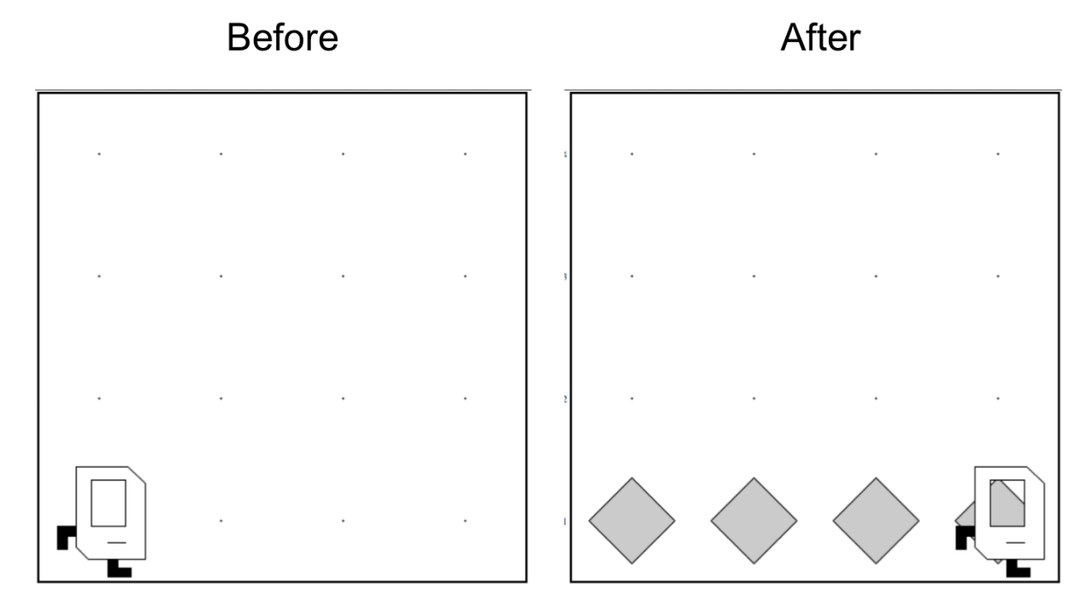
Today’s Guiding Problem
Fill a street with beepers in a world of any size.
?
Notes:
Executes statements in order – NOT repeating each one individually

Slide 21
Today’s Guiding Problem
Fill a street with beepers in a world of any size.
?
Notes:
Executes statements in order – NOT repeating each one individually

Slide 22
Today’s Guiding Problem
Fill a street with beepers in a world of any size.
?
def main(): for i in range(?): put_beeper() move()
Notes:
Executes statements in order – NOT repeating each one individually

Slide 23
Today’s Guiding Problem
Fill a street with beepers in a world of any size.
?
def main(): for i in range(?): put_beeper() move()
Notes:
Executes statements in order – NOT repeating each one individually

Slide 24
Control flow: For Loops
For loops are great when we know exactly how many times we want to repeat a block of code
Notes:
Executes statements in order – NOT repeating each one individually

Slide 25
Control flow: For Loops
For loops are great when we know exactly how many times we want to repeat a block of code
But sometimes, we want to repeat a block of code as long as some condition is true
Notes:
Executes statements in order – NOT repeating each one individually

Slide 26
Conditions
Test | Opposite | What it checks
front_is_clear() | front_is_blocked() | Is there a wall in front of Karel?
left_is_clear() | left_is_blocked() | Is there a wall to Karel’s left?
right_is_clear() | right_is_blocked() | Is there a wall to Karel’s right?
beepers_present() | no_beepers_present() | Are there beepers on this corner?
facing_north() | not_facing_north() | Is Karel facing north?
facing_east() | not_facing_east() | Is Karel facing east?
facing_south() | not_facing_south() | Is Karel facing south?
facing_west() | not_facing_west() | Is Karel facing west?
Notes:
Executes statements in order – NOT repeating each one individually

Slide 27
Control flow: While Loops
while condition:
statement
statement
...
Repeats the statements in the body until condition is no longer true.
Each time, Karel executes all statements, and then checks the condition.
Notes:
Executes statements in order – NOT repeating each one individually

Slide 28
Control flow: While Loops
def main(): while front_is_clear(): put_beeper() move()
put_beeper()
Notes:
Executes statements in order – NOT repeating each one individually

Slide 29
Control flow: While Loops
condition
def main(): while front_is_clear(): put_beeper() move()
put_beeper()
Notes:
Executes statements in order – NOT repeating each one individually

Slide 30
Control flow: While Loops
def main(): while front_is_clear(): put_beeper() move()
put_beeper()
body
Notes:
Executes statements in order – NOT repeating each one individually

Slide 31
Control flow: While Loops
def main(): while front_is_clear(): put_beeper() move()
put_beeper()
Command outside of loop
Notes:
Executes statements in order – NOT repeating each one individually

Slide 32
Loops Overview
I want Karel to repeat some commands!
Know how many times
Don’t know how many times
for loop
while loop
Notes:
E.g. “pick up all the beepers on this square”
E.g. “turn until you’re facing west”
E.g. “put down 5 beepers”

Slide 33
Lecture Plan
Review
while loops and conditions
Fencepost problem

Slide 34

Fencepost
I want Karel to put down a row of beepers until it reaches a wall. How do I do this?
Let’s first pretend the program must only work for this world. What commands should Karel execute?

Slide 35
Fencepost
I want Karel to put down a row of beepers until it reaches a wall. How do I do this?
put_beeper()
move()
put_beeper()
move()
put_beeper()
move()
put_beeper()

Slide 36

Fencepost
I want Karel to put down a row of beepers until it reaches a wall. How do I do this?
put_beeper()
move()
put_beeper()
move()
put_beeper()
move()
put_beeper()

Slide 37
Fencepost
I want Karel to put down a row of beepers until it reaches a wall. How do I do this?
put_beeper()
move()
put_beeper()
move()
put_beeper()
move()
put_beeper()

Slide 38
Fencepost
I want Karel to put down a row of beepers until it reaches a wall. How do I do this?
put_beeper()
move()
put_beeper()
move()
put_beeper()
move()
put_beeper()

Slide 39
Fencepost
I want Karel to put down a row of beepers until it reaches a wall. How do I do this?
put_beeper()
move()
put_beeper()
move()
put_beeper()
move()
put_beeper()

Slide 40
Fencepost
I want Karel to put down a row of beepers until it reaches a wall. How do I do this?
put_beeper()
move()
put_beeper()
move()
put_beeper()
move()
put_beeper()

Slide 41
Fencepost
I want Karel to put down a row of beepers until it reaches a wall. How do I do this?
put_beeper()
move()
put_beeper()
move()
put_beeper()
move()
put_beeper()

Slide 42
Fencepost
I want Karel to put down a row of beepers until it reaches a wall. How do I do this?
put_beeper()
move()
put_beeper()
move()
put_beeper()
move()
put_beeper()

Slide 43
Fencepost
I want Karel to put down a row of beepers until it reaches a wall. How do I do this?
put_beeper()
move()
put_beeper()
move()
put_beeper()
move()
put_beeper()

Slide 44
Fencepost
I want Karel to put down a row of beepers until it reaches a wall. How do I do this?
put_beeper()
move()
put_beeper()
move()
put_beeper()
move()
put_beeper()

Slide 45
Fencepost
I want Karel to put down a row of beepers until it reaches a wall. How do I do this?
put_beeper()
move()
put_beeper()
move()
put_beeper()
move()
put_beeper()
We must put 4 beepers but move 3 times!

Slide 46
Fencepost
I want Karel to put down a row of beepers until it reaches a wall. How do I do this?
We must put 4 beepers but move 3 times!
while front_is_clear():
put_beeper()
move()
put_beeper()

Slide 47
Fencepost
I want Karel to put down a row of beepers until it reaches a wall. How do I do this?
while front_is_clear():
put_beeper()
move()
put_beeper()

Slide 48
Fencepost
I want Karel to put down a row of beepers until it reaches a wall. How do I do this?
while front_is_clear():
put_beeper()
move()
put_beeper()

Slide 49
Fencepost
I want Karel to put down a row of beepers until it reaches a wall. How do I do this?
while front_is_clear():
put_beeper()
move()
put_beeper()

Slide 50
Fencepost
I want Karel to put down a row of beepers until it reaches a wall. How do I do this?
while front_is_clear():
put_beeper()
move()
put_beeper()

Slide 51
Fencepost
I want Karel to put down a row of beepers until it reaches a wall. How do I do this?
while front_is_clear():
put_beeper()
move()
put_beeper()

Slide 52
Fencepost
I want Karel to put down a row of beepers until it reaches a wall. How do I do this?
while front_is_clear():
put_beeper()
move()
put_beeper()

Slide 53
Fencepost
I want Karel to put down a row of beepers until it reaches a wall. How do I do this?
while front_is_clear():
put_beeper()
move()
put_beeper()

Slide 54
Fencepost
I want Karel to put down a row of beepers until it reaches a wall. How do I do this?
while front_is_clear():
put_beeper()
move()
put_beeper()

Slide 55
Fencepost
I want Karel to put down a row of beepers until it reaches a wall. How do I do this?
while front_is_clear():
put_beeper()
move()
put_beeper()

Slide 56
Fencepost
I want Karel to put down a row of beepers until it reaches a wall. How do I do this?
while front_is_clear():
put_beeper()
move()
put_beeper()

Slide 57
Fencepost
I want Karel to put down a row of beepers until it reaches a wall. How do I do this?
while front_is_clear():
put_beeper()
move()
put_beeper()

Slide 58
Fencepost
I want Karel to put down a row of beepers until it reaches a wall. How do I do this?
while front_is_clear():
put_beeper()
move()
put_beeper()

Slide 59
Fencepost
I want Karel to put down a row of beepers until it reaches a wall. How do I do this?
while front_is_clear():
put_beeper()
move()
put_beeper()

Slide 60
Fencepost
I want Karel to put down a row of beepers until it reaches a wall. How do I do this?
put_beeper()
move()
put_beeper()
move()
...
put_beeper()
We must put N beepers but move N-1 times!

Slide 61
Fencepost
I want Karel to put down a row of beepers until it reaches a wall. How do I do this?
put_beeper()
move()
put_beeper()
move()
put_beeper()
move()
put_beeper()

Slide 62
Fencepost
I want Karel to put down a row of beepers until it reaches a wall. How do I do this?
put_beeper()
move()
put_beeper()
move()
put_beeper()
move()
put_beeper()

Slide 63
Fencepost
I want Karel to put down a row of beepers until it reaches a wall. How do I do this?
put_beeper()
while front_is_clear():
move()
put_beeper()

Slide 64
Fencepost
I want Karel to put down a row of beepers until it reaches a wall. How do I do this?
put_beeper()
move()
put_beeper()
move()
put_beeper()
...
move()
put_beeper()
We must put N beepers but move N-1 times!

Slide 65
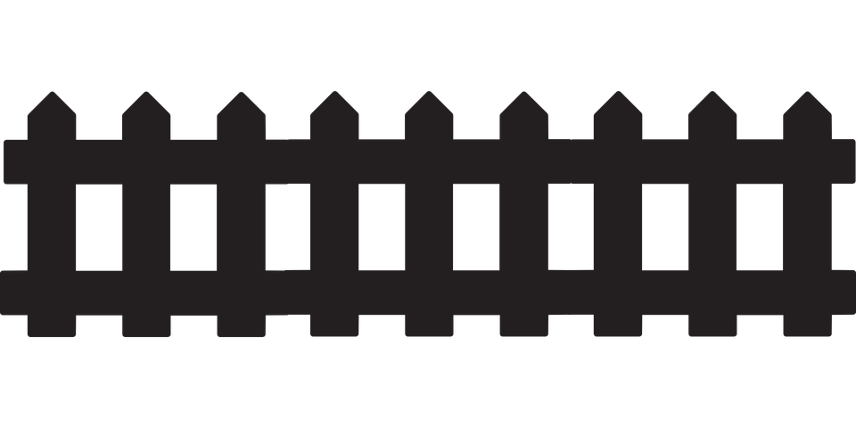
Fencepost Problem
8 fence segments, but 9 posts!

Slide 66
Fencepost Structure
The fencepost structure is useful when you want to loop a set of statements but do one part of that set 1 additional time.
put_beeper() # post
while front_is_clear():
move() # fence
put_beeper() # post
# or...
while front_is_clear():
put_beeper() # post
move() # fence
put_beeper() # post

Slide 67
What’s Next?
Time for your section’s quickstart time!
Check your section’s Ed group for more information

